Slide 1
Introduction to Software Development
Week 4 Day 3
Led by: Emily Crose
for
Oakland University

Slide 2
Previous session review

Slide 3

Questions From Previous session?

Slide 4

Terms to listen for
Binaries
Executable files
Branching
Isolated areas of code development
Pull Request
A request to the owner of a repository to merge new code
Merge
Adding new code to a main branch
Pentesting
Purposeful exploitation of a tool or product to determine security standards

Slide 5
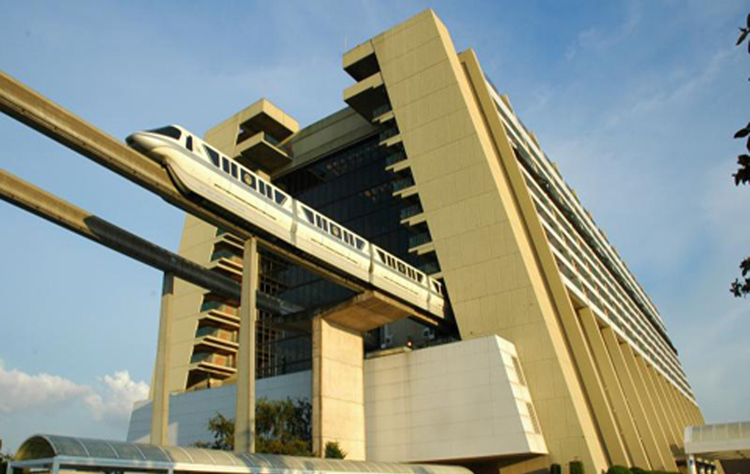
Notes:
Does anyone recognize this building? It’s the Contemporary Resort at Disneyworld in Florida. This building was opened in 1971. Does anyone happen to know how this resort was built?

Slide 6


Slide 7
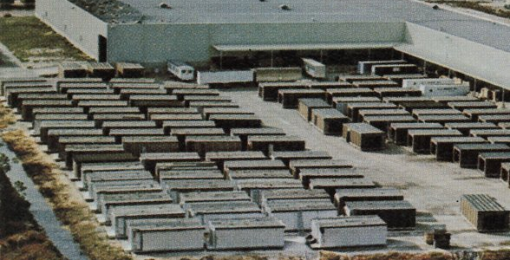
Notes:
Here’s a photo of the rooms in the contemporary hotel finished outside of the factory they were made in

Slide 8
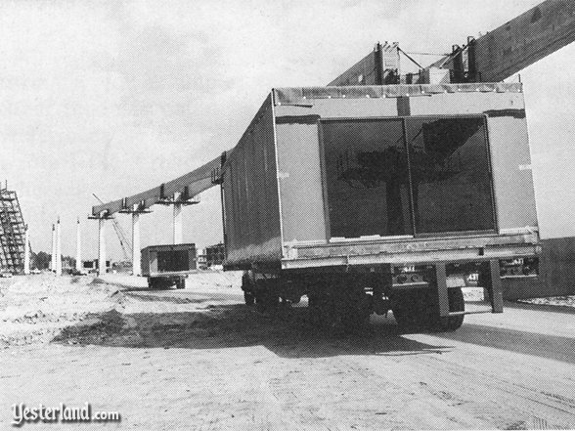

Slide 9
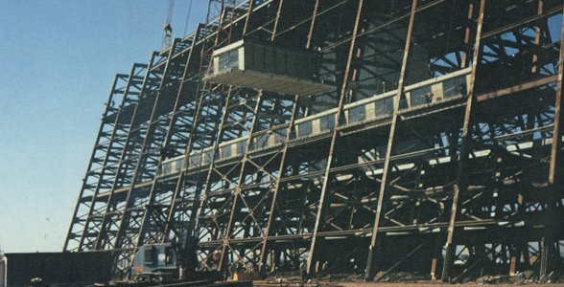

Slide 10

Modular Coding
Notes:
We can take the same concepts from the building of this hotel and apply them to building modular code.

Slide 11
Modularity Definition
the degree to which a system’s components may be separated and recombined, often with the benefit of flexibility and variety in use.
Notes:
So why would modularity be a helpful coding aspect to observe?

Slide 12
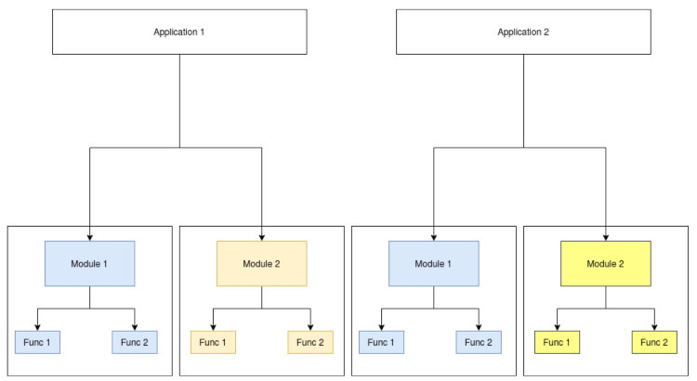
How to program modularly
Equivalent Coding Standards
Standard APIs
Reliable frameworks
Designing for testability

Slide 13
Why program modularly?
Plug & Play code
Cheaper
Easier to build

Slide 14
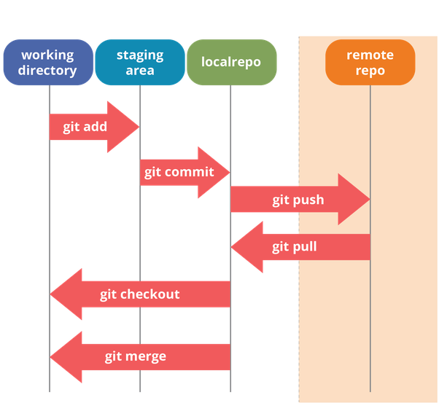
Workflow revisited
Notes:
If we go back to our workflow slide, let’s remember what we need to do before we put in our pull request

Slide 15

Branching With Teams

Slide 16
Branch Naming conventions
What type of branch naming convention works for you?
[Username] - <feature>
[Jira ticket #] - <feature>
[github issue number] – {username} - <feature>

Slide 17

Pull
Notes:
When we make changes, we need to pull those changes, especially if we’ve just merged them!

Slide 18

Forking

Slide 19
Editing a forked repository
Notes:
Practical slide – show what happens when a repository is forked

Slide 20
Pull Request

Slide 21
Code reviews
Notes:
When we add a new Pull Request, we should specify some members of our team who are capable of doing code reviews. These can just be static code reviews, they don’t need to be load-up-and-execute reviews (unless you want them to be!) How thorough you get is totally up to you!

Slide 22
Code review
Allows changes to be approved
Limits bad code merges
Adds a layer of safety
Notes:
Before we approve a pull request, we need to validate that the code is in good shape. To do this, we will review the code, and approve it. My team calls this “stamping” changes. Within git, you can change how many reviewers are needed before you can merge the changes.

Slide 23
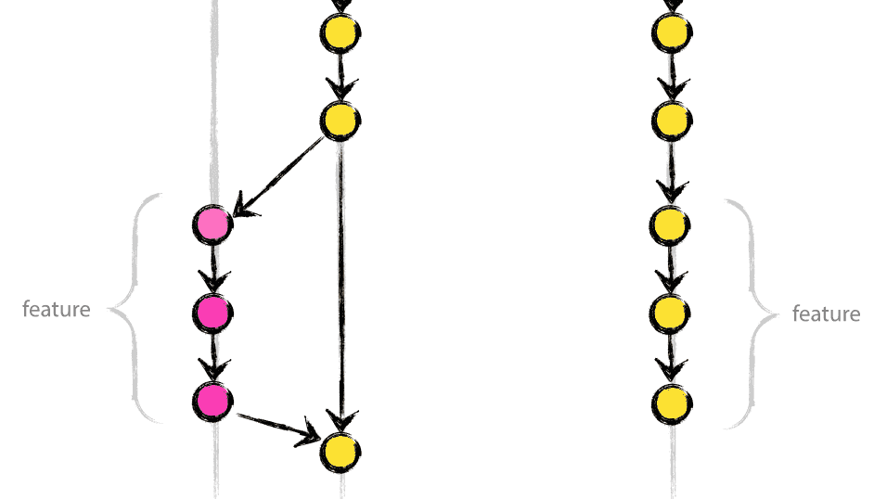
Merging Changes

Slide 24
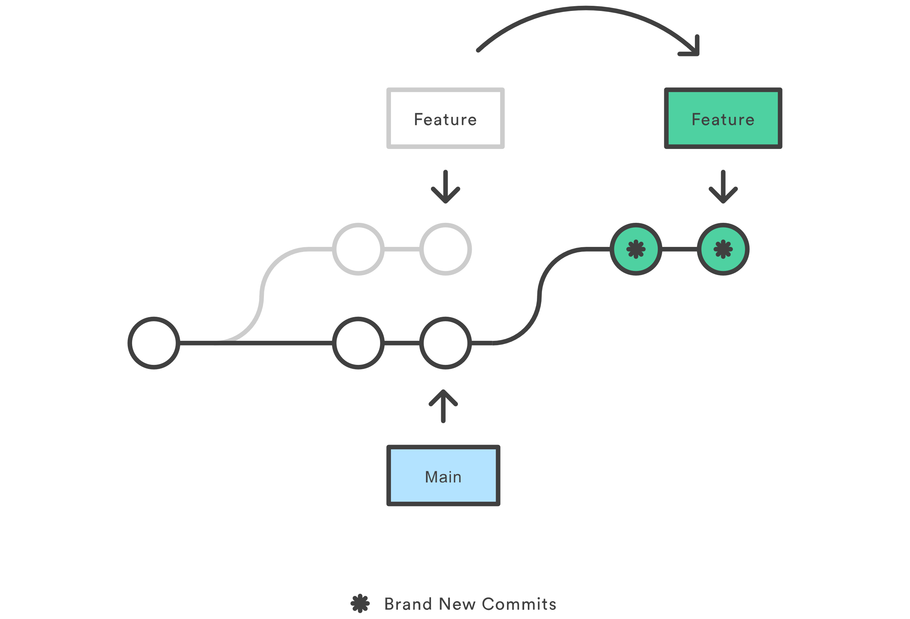
Rebasing
Notes:
Rebasing is the process of moving or combining a sequence of commits to a new base commit. Rebasing is most useful and easily visualized in the context of a feature branching workflow. The primary reason for rebasing is to maintain a linear project history. For example, consider a situation where the main branch has progressed since you started working on a feature branch.

Slide 25

Release Candidates

Slide 26

Building binaries
Notes:
Do we need to have a pipeline for building releases? This is where Jenkins or some other build-automation software may come in.

Slide 27

Release Notes

Slide 28
Practicing With Git
https://learngitbranching.js.org/
Alternatives
https://gitimmersion.com/lab_01.html

Slide 29

10 minute break

Slide 30

Licensing

Slide 31

Licensing
Software can be copyrighted
How do we protect our “Intellectual Property”?

Slide 32
Broad categories of software licensing
Weak Copyleft
Copyleft
Commercial or Proprietary
Dual
Public Domain

Slide 33

Permissive
Permissive
Minimally restrictive on modifications or redistribution
Typically, only require acknowledgements

Slide 34


Weak Copyleft
Allows linking to open-source libraries
Minimal requirements
Modifying the library is more complicated than permissive
Examples:
Gnu Lesser General Public License (GLPL)
Mozilla Public License (MPL)
CDDL
Eclipse

Slide 35

Copyleft
A.K.A. “Reciprocal” licenses or “Restrictive” licenses
Not as commercially friendly
Requires publication of source code for derivative works
Not good for commercial products!
Examples:
Gnu Public License (GPL)

Slide 36

MIT
Allows for unlimited copy, modify, merge, publish, distribution, sublicense and sale
Designed to encourage software innovation
Does NOT provide any warrantee, and excludes all liability on the author
This is my favorite type of license.
Notes:
The MIT license is great. It provides for unlimited rights to copy, modify, merge, publish, distribute, sublicense, and sale of software or software derivatives.

Slide 37


Commercial/Proprietary
Most restrictive
Typically used by corporations
Typically closed source

Slide 38

Dual
Differs for different types of users
Examples:
Server-Side Public License (SSPL)

Slide 39

Public Domain
Copyright protections do not apply
Hard to find software in this category
Most permissive

Slide 40

Unlicensed
Can be complicated
Can be legally risk
Notes:
For companies to use this, they will need to request a license to be applied to the software work. It can be complicated to use unlicensed works if there’s no explicit license attached to it.

Slide 41

Licensing concerns
Notes:
You need to concern yourself with licensing types, and how they might impact you. For example, you may be building software using a library that relies on a license that does not allow for commercial use.

Slide 42
10 minute break

Slide 43

Architecture Design

Slide 44

Functional Testing

Slide 45

What is the purpose of testing?
Notes:
We’re going to talk about a lot of different types of testing in the next session, so it’s important that we fully understand the reasons we’re going through all the trouble to do this testing in the first place.
One obvious reason that we do testing is obviously for the overall improvement of the product, but there are selfish reasons for why we do testing as well. One of those selfish reasons is to root out issues we will need to deal with at some point in the future. We know that what we’re working on isn’t perfect, and it never will be. But by testing, we will be able to spot problems ahead of time which will give us an early warning for things we may need to prioritize sooner than later.

Slide 46
Manual testing?
Takes longer
Not scalable
Tedious!

Slide 47
Automated Testing
What does our testing pipeline look like from an architecture perspective?
What types of tests do we need to perform?
Regression testing
QA testing
User Acceptance Testing
Load testing
Performance Testing
Security Testing

Slide 48
Testing In Depth
Load Testing
Stress Testing
Performance Testing
Security Testing
Notes:
When we’ve matured our processes sufficiently, we may start to look at more in-depth testing.

Slide 49
Unit Testing
We added a feature!
Does it do what it’s supposed to do?
This should be done for every new feature!

Slide 50
Load Testing
Average number of concurrent users in the tool at a time
Beneath “peak” use
This is the REGULAR amount of traffic you expect to get
Does our app scale with more users?
We can test for this!
Notes:
Load testing tests the number of users or “average load” of requests a server can expect in its regular routine.

Slide 51

Stress testing
ABOVE average use
Uncommon amount of traffic
Can we load balance?

Slide 52

Performance Testing
How quickly can we load information?
Do we see any lags in transfer under regular use?
Lags in higher-than-average use?

Slide 53

Security testing
How can we break this app?
Can we get access we shouldn’t have?
Can we get information we shouldn’t have?
Can we make the app do something unexpected?
Do we need to fully pentest this app?

Slide 54

Pentesting?
Can we do this “in-house”?
Is there a cost associated with this?
Probably!
Is doing a pentest worth the cost?
What if we don’t do a pentest?

Slide 55
Product pentesting options
In-house penetration test (pentest)
Do we have the expertise to do this in-house?
Third-party testing
Is there a legal or regulatory reason we should do a third-party pentest?

Slide 56
Architecture pentesting
Should we pentest our back-end architecture?
Is there a cost associated with this?
Probably!

Slide 57
Outcomes from testing
Bug tickets
Feature Requests
Reporting
We can show this to regulators!

Slide 58

Session Review

Slide 59
Question or clarifications?

Slide 60
See you next time!

